Slide 1
Presentation of C language project
:Digital huarong road

Slide 2
What does ereryone do in our group?
A：Inital interface generation(The numbers are not messed up)
B:The generation of the interface before the game
starts(the numbers have been messed up and 0
is in the right position )
C:Players'operation
D:Decision of the result and game optimization(time keeping
and implementation of multiple schema choices)

Slide 3
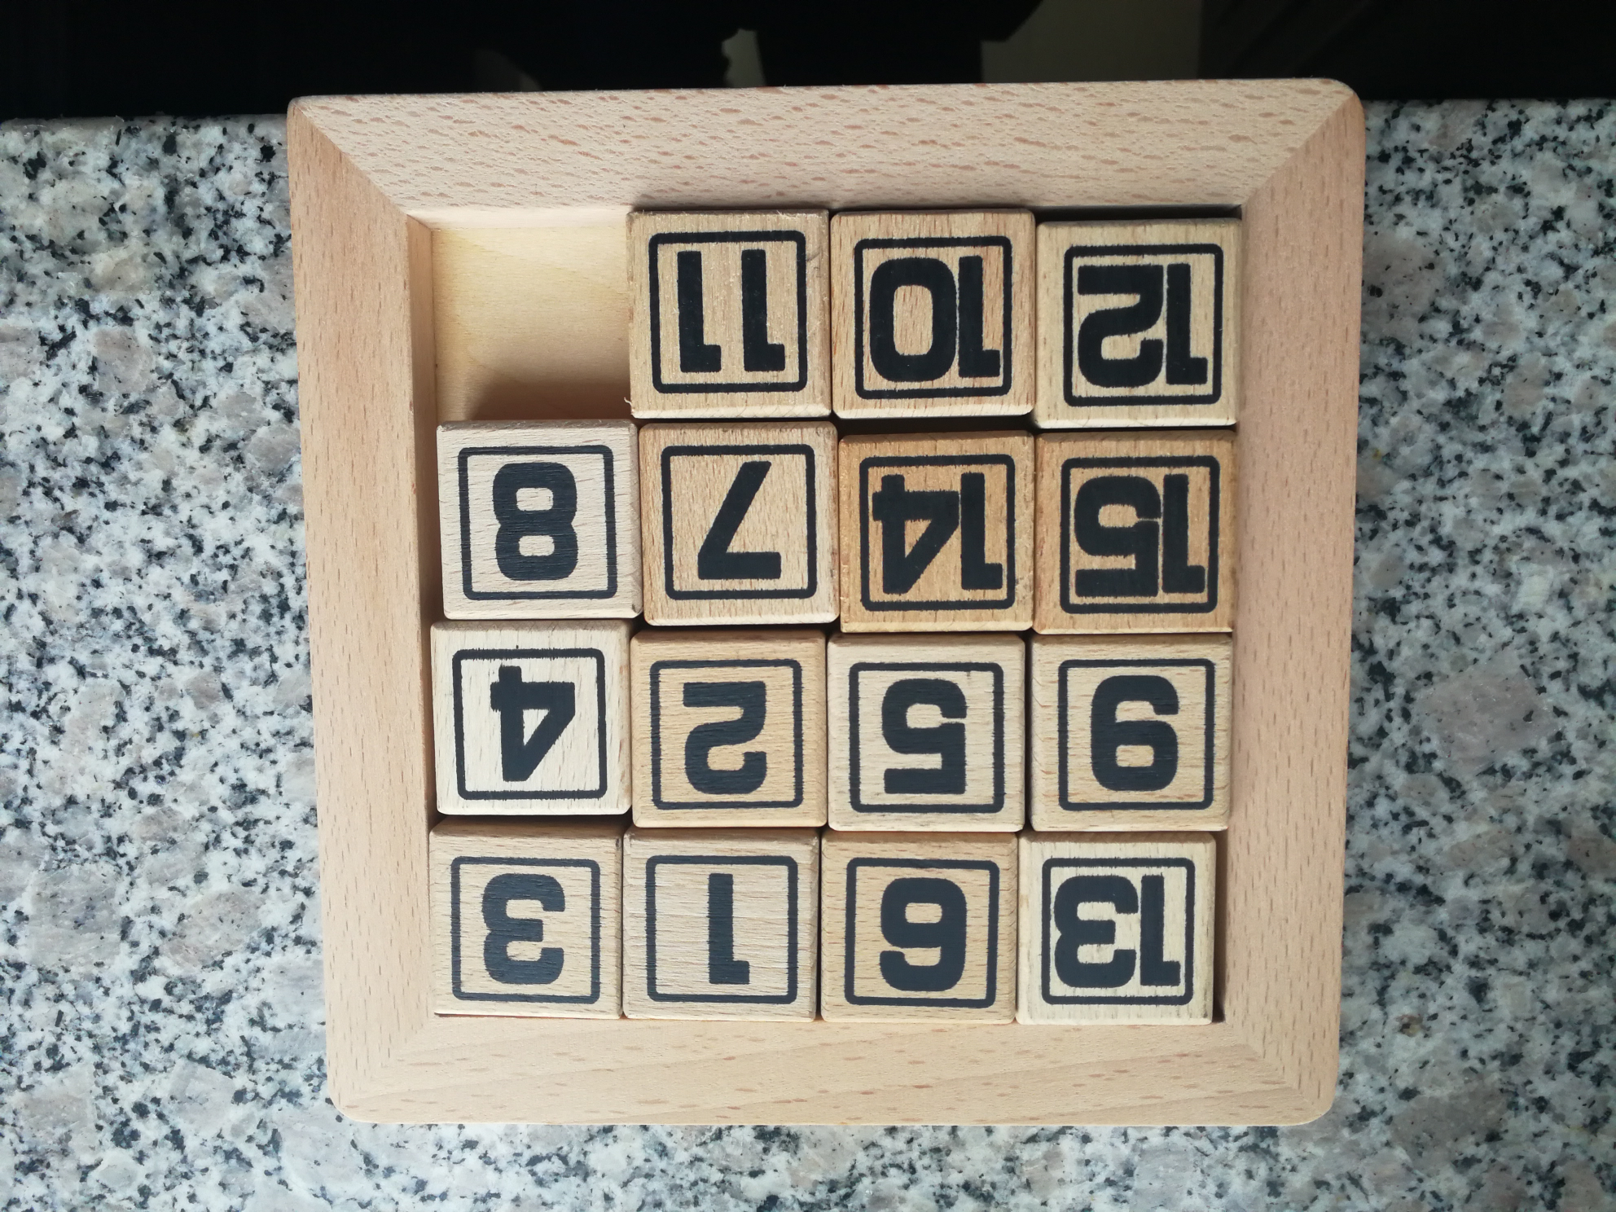
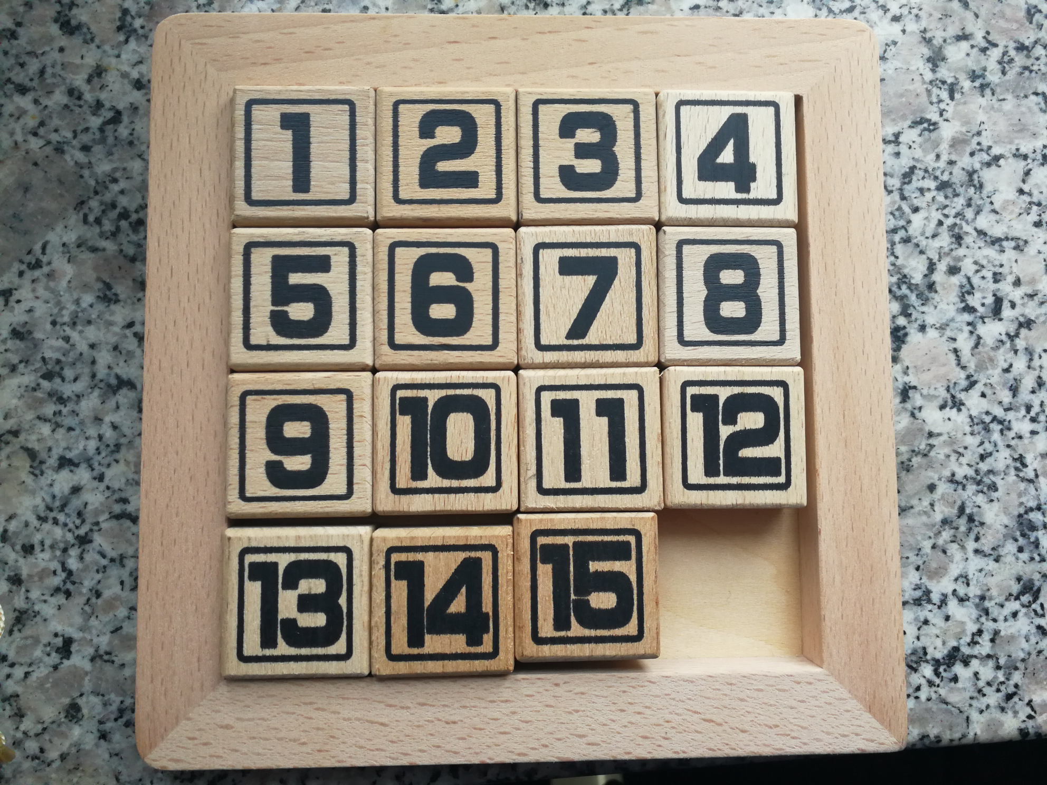
What is the rule of the game?
What have we done?

Slide 4
Problems and solution
CHAPTER 01
How to create the array
CHAPTER 02
About the random movement
CHAPTER 03
moving 0 to the right position
CHAPTER 04
movement of players

Slide 5
How to create the array
Analysis of the problem
F_List
Tnumber=16
16+2-Tnumber
→ Right = Tmp
→ Right = NULL
1
2
3
4
L
5
6
7
8
Tmp
9
10
11
12
Tnumber --
13
14
15
0

Slide 6
Start
How to create the array
Flow chart
Int Tnumber
No
Tnumber>2
Yes
print
Tmp=malloc(sizeof(struct Node))
Tmp –>Element
+(number*number-Tnumber=2)
Tnumber--
Tmp –>posite= Tmp –>Element
Tmp –>Right=Null
L->Right=Tmp

Slide 7
About the random movement
Analysis of the problem
To move the numbers randomly,we
should firstly create a function
which can provide the random
numbers and do sth to make
sure the number we produce
each time is different.Then the
random numbers can decide the
direction of movement.

Slide 8
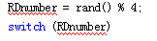
About the random movement
Flow chart
Start
RDnumber
0
1
2
3
srand((int)time(Null))
Upmove()
Downmove()
Leftmove()
Rightmove()
RDnumber=rand()%4
End
The process is cycled for many times to guarantee a good initial interface.
The functions of direction movement just exchange the corresponding two number.

Slide 9

Moving 0 to the right positon
Analysis of the problem
Now we guarantee that the numbers
are messed up.But we don't know where
the 0 is and we should find it,then
move it to the lower right corner.
For finding the 0,we can firstly verify the
first one.If it isn't 0,then verify the next one,
then we can find where 0 is.
For moving 0,we can firstly move 0 to the rightmost,
it means we should make sure the position of 0 is a multiple
of 4.Then we move it down until the position of it is 4*4.

Slide 10
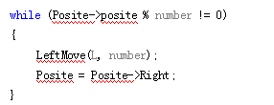
start
Moving 0 to the right position
Flow chart
Position Posite;
Posite=FindZero()
position Tmp,Posite
Leftmove;
Posite=Posite->Right
Posite->posite%number=0?
Posite=Tmp->Right
No
Tmp->Element=0?
Upmove
Yes
no
Y
Posite->posite=number*number?
yes
ye
return Tmp
No
Yes
finish

Slide 11
Move of players：
Problem and the analysis
1、How to let players play with the keyboard
2、How to show the new matrix continuously
_kbhit() _getch()

Slide 12
Movement of players
flow chart
Start
PutIn
W
S
A
D
Q
_kbhit()
Upmove()
Downmove()
Leftmove()
Rightmove()
exit(0)
PutIn=_getch()
The process is cycled while the arrangement of the number doesn't match the final result.
End
Also,once we use the function of directions, the computer will clear the screen and then print the new matrix
The functions of direction movement just exchange the corresponding two number.

Slide 13
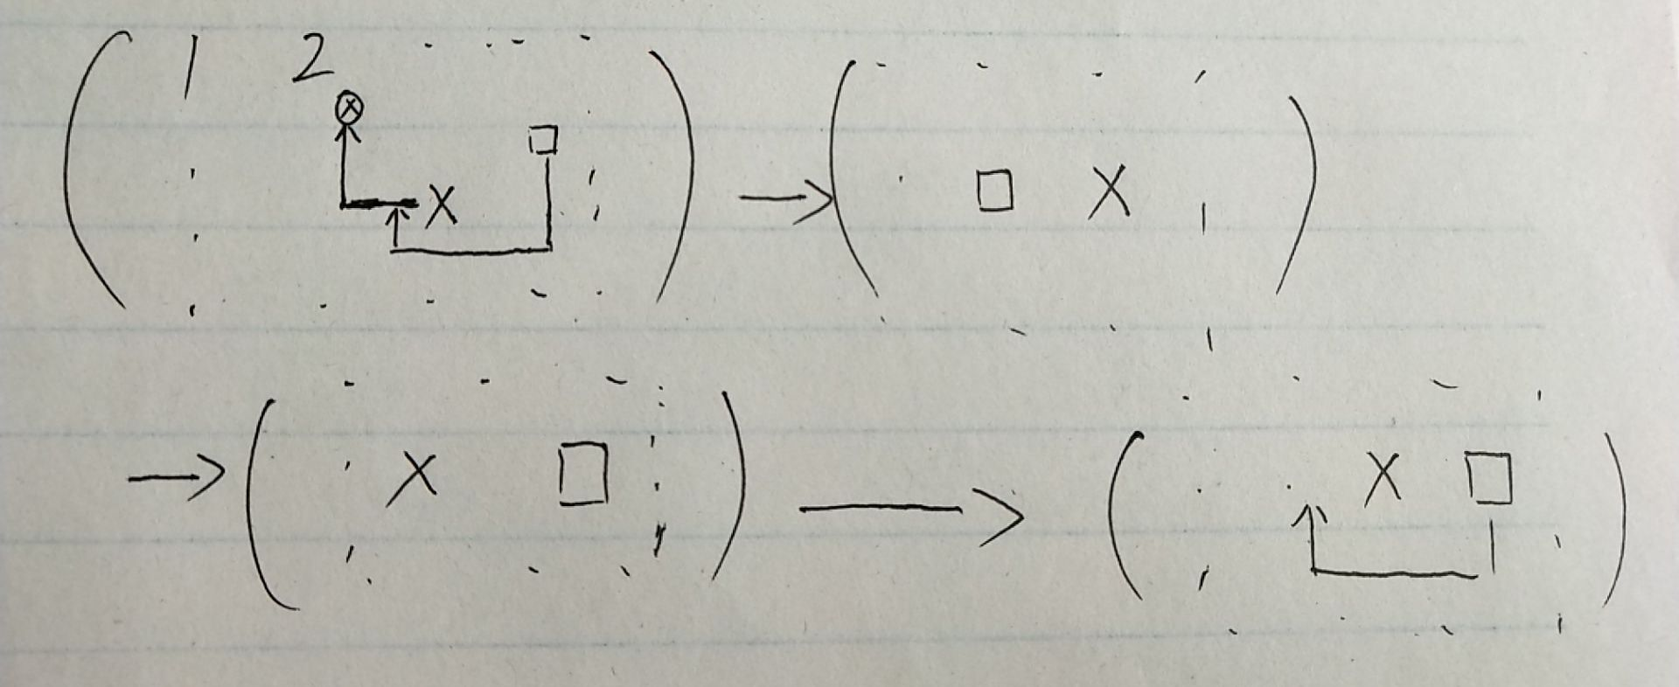
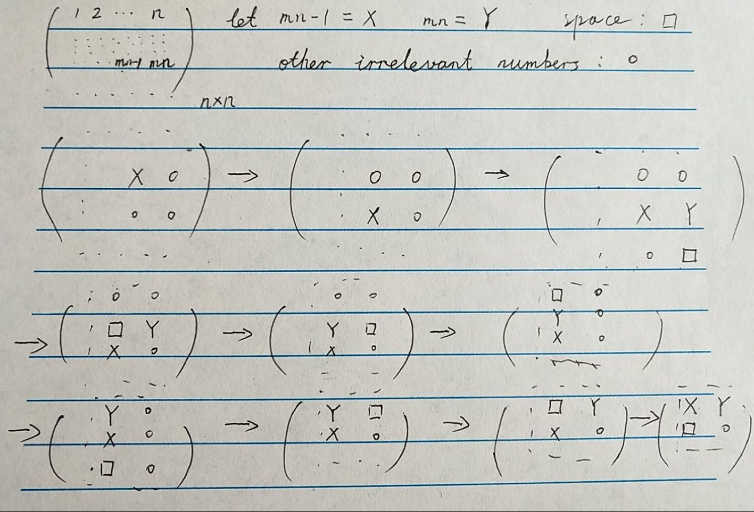

Slide 14
THANK YOU!

